Slide 1
1 Thessalonians 3:6-4:8
a cd of this message will be available (free of charge) immediately following today’s service
a podcast will be available later in the week at calvaryokc.com
This Photo by Unknown Author is licensed under CC BY-SA

Slide 2
1 Thessalonians 3:6–4:8 ~ ⁶ But now that Timothy has come to us from you, and brought us good news of your faith and love, and that you always have good remembrance of us, greatly desiring to see us, as we also to see you — ⁷ therefore, brethren, in all our affliction and distress we were comforted concerning you by your faith. ⁸ For now we live, if you stand fast in the Lord.
⁹ For what thanks can we render to God for you, for all the joy with which we rejoice for your sake
1 Thessalonians 3:6-4:8

Slide 3
1 Thessalonians 3:6–4:8 ~ before our God, ¹⁰ night and day praying exceedingly that we may see your face and perfect what is lacking in your faith?
¹¹ Now may our God and Father Himself, and our Lord Jesus Christ, direct our way to you. ¹² And may the Lord make you increase and abound in love to one another and to all, just as we do to you, ¹³ so that He may establish your hearts blameless in holiness before our God and Father at the coming of our Lord Jesus Christ with all
1 Thessalonians 3:6-4:8

Slide 4
1 Thessalonians 3:6–4:8 ~ His saints.
¹ Finally then, brethren, we urge and exhort in the Lord Jesus that you should abound more and more, just as you received from us how you ought to walk and to please God; ² for you know what commandments we gave you through the Lord Jesus.
³ For this is the will of God, your sanctification: that you should abstain from sexual immorality; ⁴ that each of you should know how to possess his own vessel in sanctification and honor,
1 Thessalonians 3:6-4:8

Slide 5
1 Thessalonians 3:6–4:8 ~ ⁵ not in passion of lust, like the Gentiles who do not know God; ⁶ that no one should take advantage of and defraud his brother in this matter, because the Lord is the avenger of all such, as we also forewarned you and testified. ⁷ For God did not call us to uncleanness, but in holiness. ⁸ Therefore he who rejects this does not reject man, but God, who has also given us His Holy Spirit.
1 Thessalonians 3:6-4:8

Slide 6
1 Thessalonians 3:6-4:8

Slide 7
celebrate
celibate
1 Thessalonians 3:6-4:8

Slide 8
1 Thessalonians 3:6-4:8

Slide 9
1 Thessalonians 3:6-4:8

Slide 10
1 Thessalonians 3:6-4:8

Slide 11
exceedingly ~ huperekperissou
huper ~ over
ek ~ out (exit)
perissos ~ over and above
Eph. 3:20 ~ Now to Him who is able to do exceedingly abundantly above all that we ask or think, according to the power that works in us,
George Findlay ~ “a triple Pauline intensive”
1 Thessalonians 3:6-4:8

Slide 12
perfect ~ katartizō – mending nets, setting broken bones, equipping
Eph. 4:11-12 ~ ¹¹ And He Himself gave some to be apostles, some prophets, some evangelists, and some pastors and teachers, ¹² for the equipping of the saints for the work of ministry, for the edifying of the body of Christ,
1 Thessalonians 3:6-4:8

Slide 13
1 Thessalonians 3:6-4:8

Slide 14
abound ~ perisseuō – NIV, overflow
1 Thessalonians 3:6-4:8

Slide 15
1 Thessalonians 3:6-4:8

Slide 16
saints ~ hagioi – NIV, holy ones
Used exclusively of believers in the New Testament
1 Thessalonians 3:6-4:8

Slide 17
1 Thessalonians 3:6-4:8

Slide 18
1 Thess. 1:10 ~ and to wait for His Son from heaven, whom He raised from the dead, even Jesus who delivers us from the wrath to come.
1 Thess. 2:19-20 ~ ¹⁹ For what is our hope, or joy, or crown of rejoicing? Is it not even you in the presence of our Lord Jesus Christ at His coming? ²⁰ For you are our glory and joy.
1 Thessalonians 3:6-4:8

Slide 19
1 Thessalonians 3:6-4:8

Slide 20
walk ~ peripateō – to walk around
ought ~ dei – it is necessary
1 Thessalonians 3:6-4:8

Slide 21
1 Thessalonians 3:6-4:8

Slide 22
sanctification ~ hagiosmos
1 Thessalonians 3:6-4:8

Slide 23
1 Thessalonians 3:6-4:8

Slide 24
sexual immorality ~ porneia – all illicit sex
Not moicheuō – adultery
1 Thessalonians 3:6-4:8

Slide 25
1 Thessalonians 3:6-4:8

Slide 26
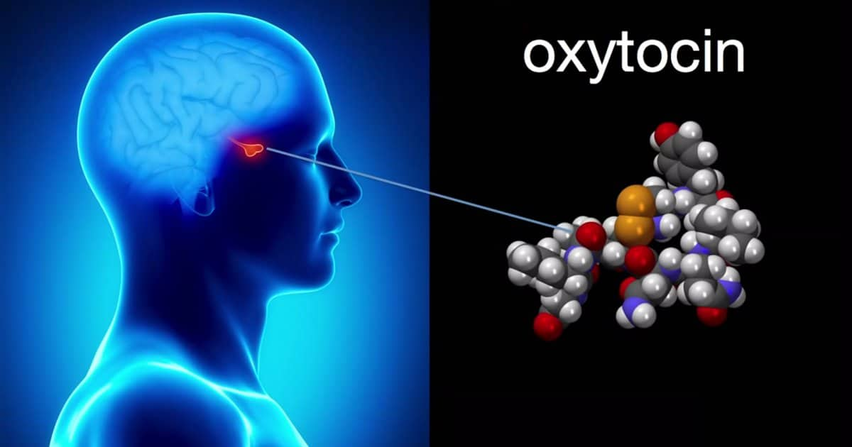
Love
hormone
Cuddle
hormone
Bonding
hormone
1 Thessalonians 3:6-4:8

Slide 27
Song of Sol. 8:4 (NLT) ~ Promise me, O women of Jerusalem,
not to awaken love until the time is right.
1 Thessalonians 3:6-4:8

Slide 28
Heb. 13:4 ~ Marriage is honorable among all, and the bed undefiled; but fornicators and adulterers God will judge.
Marriage ~ gamos – from a root mean to join or unite
1 Thessalonians 3:6-4:8

Slide 29
1 Thessalonians 3:6-4:8

Slide 30
NIV ~ that each of you should learn to control his own body
NIV margin ~ Or learn to live with his own wife; or learn to acquire a wife
1 Thessalonians 3:6-4:8

Slide 31
1 Thessalonians 3:6-4:8

Slide 32
passion of lust ~ KJV, concupiscence – epithumia
literally, to burn upon
1 Thessalonians 3:6-4:8

Slide 33
1 Thessalonians 3:6-4:8

Slide 34
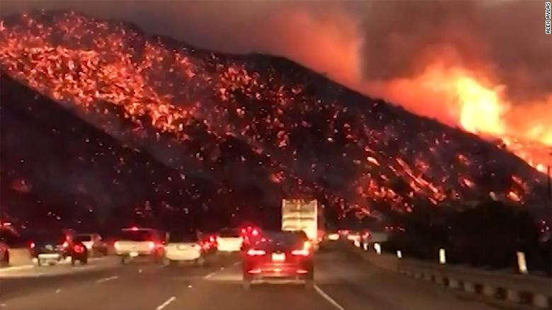
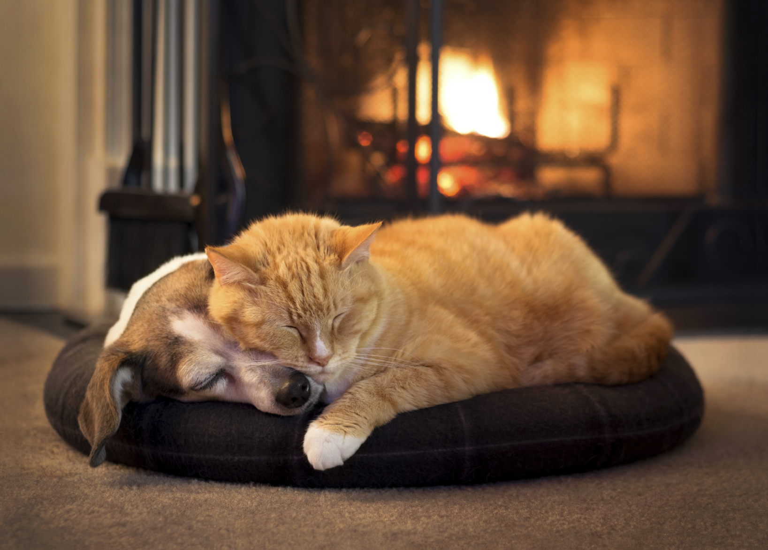
Prov. 6:27 ~ Can a man take fire to his bosom,
And his clothes not be burned?
1 Thessalonians 3:6-4:8

Slide 35
1 Thessalonians 3:6-4:8

Slide 36
uncleanness ~ akatharsia – all impurity
1 Thessalonians 3:6-4:8

Slide 37
moicheia
porneia
adultery
Illicit sex
SO-SO
ACCEPTABLE
OK
malakos
akatharsia
hagios
gamos
Marriage bed
Holy
homosexuality
unclean
Purity-o-meter
1 Thessalonians 3:6-4:8

Slide 38
1 Thessalonians 3:6-4:8

